Slide 1
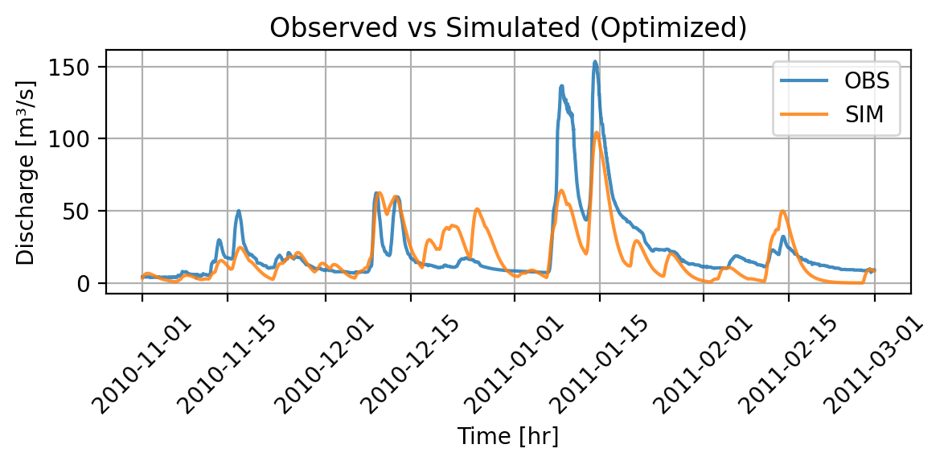
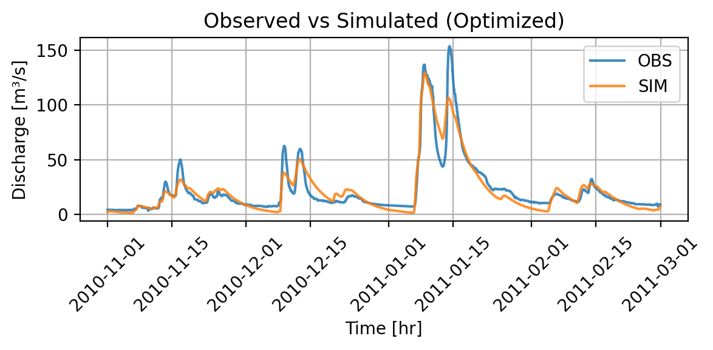
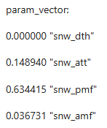






Snow module off – optimization Part 1
We set TT = -100°C
We set AMF = PMF = 0
Adapt bounds and run optimization
Simulated Discharge – snow modul off
Simulated Discharge – all modules on

Slide 2
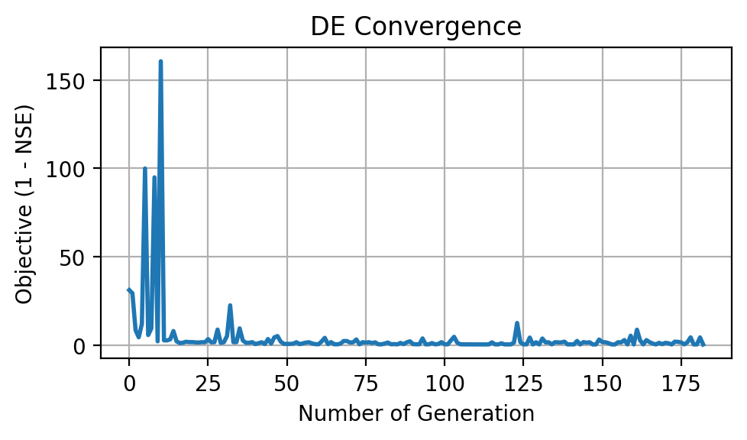
Snow module off – optimization Part 2
Schenkenau in Bavaria -> We expect melt
Less peaky as melt implies higher runoff
Interesting behavior (snow then no snow at fast melt)
High OFV
Poor convergence
Conclusion: Snow module relevant

